Slide 1
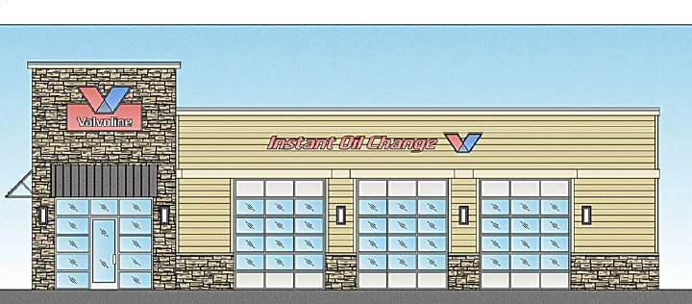
Washoe County Board of Adjustment
April 6, 2017
Administrative Permit Case Number: WADMIN18-0004 (Valvoline)

Slide 2
Case Description
Administrative permit for an Auto Repair use in the General Commercial Regulatory Zone.
2,097 sq ft building.
Located off of Buck Drive

Slide 3
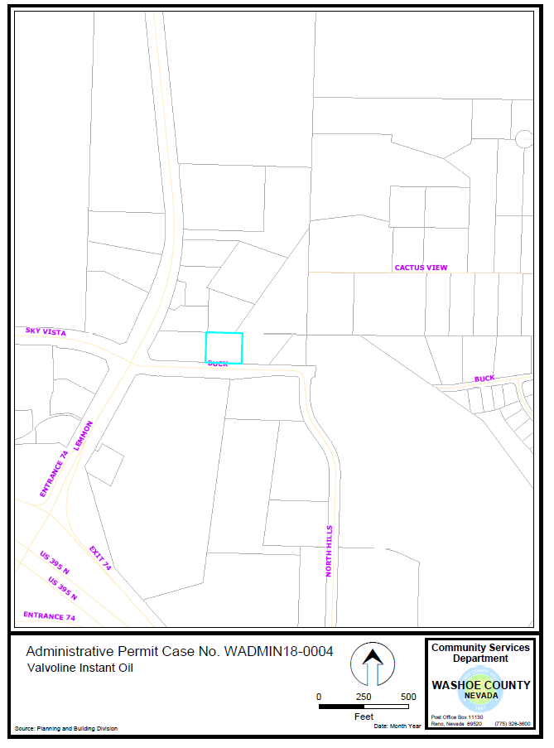
Vicinity
Map

Slide 4
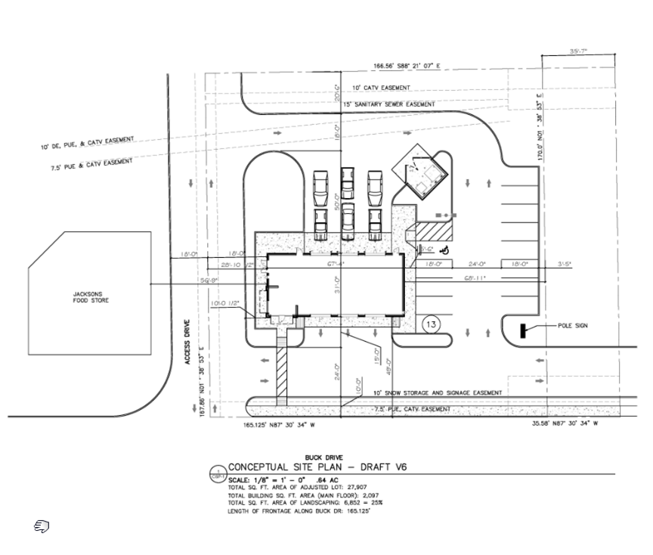

Site
Plan

Slide 5
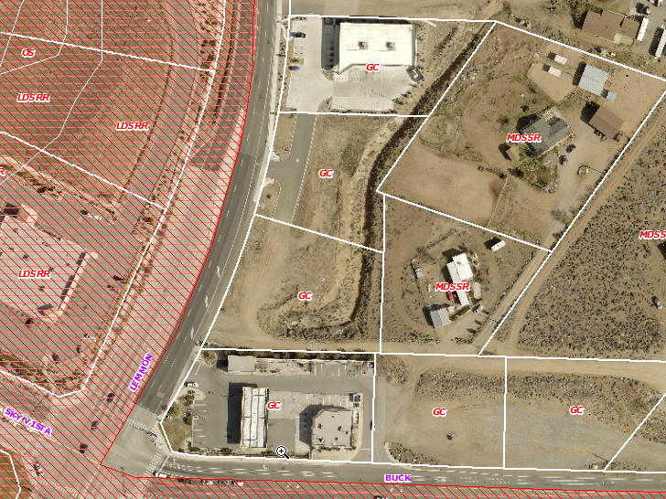
Overhead Photo of Subject Site

Slide 6
Background
Subject property is zoned General Commercial (GC)
Automotive Repair is a commercial use type defined in WCC 110.304.25
Automotive Repair is allowed in the GC zone only with a Board of Adjustment Administrative Permit

Slide 7
Analysis
No concerns, objections, or recommendations from surrounding property owners
Repairs will take place on site
Simple diagnostic testing required for vehicle registration
Findings are located on Page 8 of the Staff Report

Slide 8
Public
Notice
Parcels noticed within 1,100 feet

Slide 9
Conditions of Approval
Staff is proposing a wall or fence required between the commercial and adjacent residential uses be of long-lasting materials.
The full Conditions of Approval can be found in Exhibit A of the Staff Report.

Slide 10
Recommendation
Those agencies which reviewed the application either made no comments or recommended conditions in support of approval of the project. Therefore, after a thorough analysis and review, Administrative Permit Case Number WADMIN18-0004 is being recommended for approval with conditions.

Slide 11
Motion
I move that, after giving reasoned consideration to the information contained in the staff report and information received during the public hearing, the Board of Adjustment approve Administrative Permit Case Number WADMIN18-0004 for Valvoline Instant Oil, having made all five findings in accordance with Washoe County Development Code Section 110.808.25

